Slide 1
Project : “Operation Analytics and Investigating Metric Spik” Submitted by Aishwarya Ganapat Desai

Slide 2
Content
Case Study I and II
Project Description
Approach
Tech-Stack Used
Insights
Result
Drive Link

Slide 3
Project Description
This project mainly focuses on analyzing job data provided by a specific company with the aim of assisting the company in identifying areas for improvement. The objective is to uncover solutions to specific questions that can provide valuable insights to the operations, support, and marketing teams based on the gathered data.
Operational Analysis: Operational analysis involves the utilization of real-time data to inform the company's daily decision-making processes. This entails comprehending and elucidating abrupt shifts in critical performance indicators, such as drop in daily user engagement or a reduction in sales.

Slide 4
Approach
After a thorough examination of the data, the initial step involved extracting meaningful insights to
facilitate subsequent analysis.
Employing MySQL proved instrumental in swiftly obtaining answers to pertinent questions through straightforward queries
Tech Stack Used
I chose to utilize MySQL Workbench 8.0.34 for conducting the project's analysis.
This decision was influenced by the simplicity and efficiency of SQL queries within the tool, making it straightforward to execute queries and obtain the desired results.
Additionally, the query language itself is user-friendly and not overly complex.

Slide 5
Insights
Case Study 1: Job Data Analysis

Slide 6
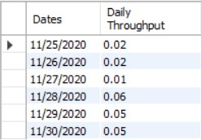
1. Jobs Reviewed Over Time:
1. To determine the job review rate per hour for each day in November 2020,
Ans: It was noticed that the highest number of jobs reviewed, reaching a peak of 218, occurred on November 28, 2020.
Througput Analysis:
To Calculate the 7-day rolling average of throughput (number of events per second). To check whether prefer using the daily metric or the 7-day rolling average for throughput, and why?
Ans: The 7-day rolling average for throughput currently stands at 0.03.
When employing the daily metric, the highest throughput, at 0.06, occurred on November 28, 2020.
.

Slide 7
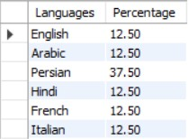

3. Language Share Analysis:
To Calculate the percentage share of each language in the last 30 days.
The percentage share for each language in last 30 days is as below table:
4. Duplicate Rows Detection:
To identify duplicate rows in the data.
It is observed that only single row is duplicated in the whole data.

Slide 8
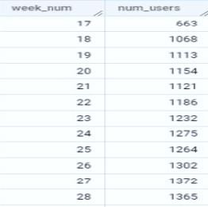
Case Study 2: Investigating Metric Spike
1. Weekly User Engagement:
To measure the activeness of users on a weekly basis.
The activeness of the users on weekly basis is as follows:

Slide 9
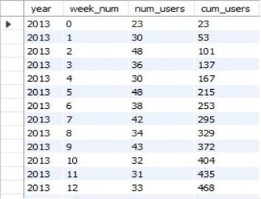

2. User Growth Analysis:
Analyze the growth of users over time for a product.
The observed growth of users over time for a product is:
3. Weekly Retention Analysis:
Analyze the retention of users on a weekly basis after signing up for a product.

Slide 10
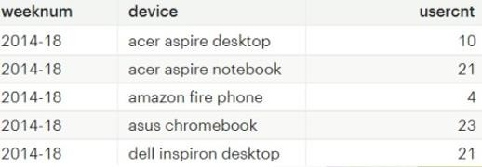

4. Weekly Engagement per Device:
To Measure the activeness of users on a weekly basis per device.
5. Email Engagement Analysis:
To Analyze how users are engaging with the email service.

Slide 11
Result
On November 28, 2020, the highest number of job reviews recorded was 218.
When evaluating throughput, a 7-day rolling average of 0.03 is preferred.
It provides a more comprehensive representation, as opposed to the daily metric, which reached its peak at 0.06 on November 28, 2020. Persian language stands out with the largest share, accounting for 37.5% of all languages used.
The 31st week stands as the pinnacle of weekly user engagement.
Notably, the 33rd week of 2014 witnessed the highest user engagement, while the lowest engagement was observed during the 35th week of the same year.
The month of August consistently records the highest number of weekly digest emails received by users.

Slide 12
Thank-You

